Slide 1
Webpage Coding
Adapted from http://www.w3schools.com

Slide 2

CSS Box Model
The CSS box model is essentially a box that wraps around every HTML element.
It consists of: margins, borders, padding, and the actual content.

Slide 3
Box Model
Content - The content of the box, where text and images appear
Padding - Clears an area around the content. The padding is transparent
Border - A border that goes around the padding and content
Margin - Clears an area outside the border. The margin is transparent
div { width: 300px; border: 15px solid green; padding: 50px; margin: 20px; }

Slide 4
Insert CSS
There are three ways of inserting a style sheet:
External CSS
Internal CSS
Inline CSS

Slide 5
External
<!DOCTYPE html> <html> <head> <link rel="stylesheet" href="mystyle.css"> </head> <body> <h1>This is a heading</h1> <p>This is a paragraph.</p> </body> </html>

Slide 6
Mystyle.css
body { background-color: lightblue; } h1 { color: navy; margin-left: 20px; }
Do not add a space between the property value and the unit
X margin-left: 20 px;
margin-left: 20px;

Slide 7
Internal CSS
<!DOCTYPE html> <html> <head> <style> body { background-color: linen; } h1 { color: maroon; margin-left: 40px; } </style> </head> <body> <h1>This is a heading</h1> <p>This is a paragraph.</p> </body> </html>

Slide 8
Inline CSS
<!DOCTYPE html> <html> <body> <h1 style="color:blue;text-align:center;">This is a heading</h1> <p style="color:red;">This is a paragraph.</p> </body> </html>

Slide 9
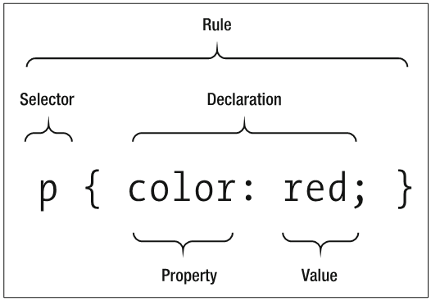
CSS rules
CSS rules are comprised of a selector, a property, and a value as follows:
selector
{
property: value;
}
Example:-
P
{
color: red;
}

Slide 10
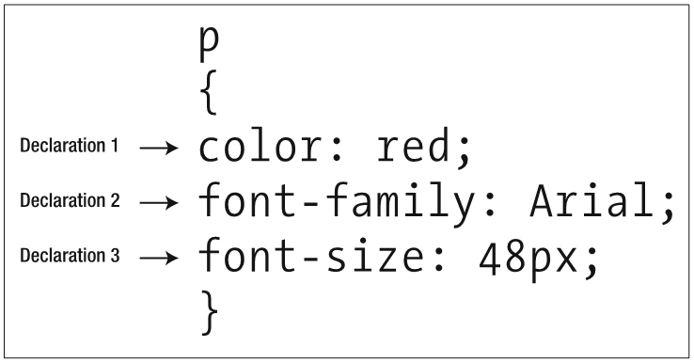
A slightly more complex rule

Slide 11
<div> The div element is a block level element used for grouping HTML elements.
<!DOCTYPE html> <html> <body> <div id="container" style="width:500px"> <div id="header" style="background-color:#FFA500;"> <h1 style="margin-bottom:0;">Main Title of Web Page</h1></div> <div id="menu" style="background- color:#FFD700;height:200px;width:100px;float:left;"> <b>Menu</b><br> HTML<br> CSS<br> JavaScript</div> <div id="content" style="background- color:#EEEEEE;height:200px;width:400px;float:left;"> Content goes here</div> <div id="footer" style="background-color:#FFA500;clear:both;text- align:center;"> Copyright © W3Schools.com</div> </div> </body> </html>

Slide 12
CSS (Cascading Style Sheets) is used to style HTML elements
<!DOCTYPE html>
<html>
<head>
<style>
h1 {color:red;}
h2 {color:blue;}
p {color:green;}
</style>
</head>
<body>
<h1>All header 1 elements will be red</h1>
<h2>All header 2 elements will be blue</h2>
<p>All text in paragraphs will be green.</p>
<a href="http://www.w3schools.com" style="text- decoration:none;">Visit W3Schools.com!</a>
</body>
</html>

Slide 13
Link to external style sheet
<!DOCTYPE html>
<html>
<head>
<link rel="stylesheet" type="text/css" href=“css1.css">
</head>
<body>
<h1>I am formatted with an external style sheet</h1>
<p>Me too!</p>
</body>
</html>

Slide 14
CSS Property Groups
Color Background and Borders Basic Box Flexible Box Text Text Decoration Fonts Writing Modes | Table Lists and Counters Animation Transform Transition Basic User Interface Multi-column | Paged Media Generated Content Filter Effects Image/Replaced Content Masking Speech Marquee
Color Properties
Property | Description | CSS
color | Sets the color of text | 1
opacity | Sets the opacity level for an element | 3

Slide 15
CSS Units – Measurement Values
% | percentage
in | inch
cm | centimeter
mm | millimeter
em
ex | one ex is the x-height of a font (x-height is usually about half the font-size)
pt | point (1 pt is the same as 1/72 inch)
pc | pica (1 pc is the same as 12 points)
px | pixels (a dot on the computer screen)
1em is equal to the current font size. 2em means 2 times the size of the current font. E.g., if an element is displayed with a font of 12 pt, then '2em' is 24 pt. The 'em' is a very useful unit in CSS, since it can adapt automatically to the font that the reader uses

Slide 16
HTML Character Sets
What is the correct character encoding to use in HTML?
For HTML5, the default character encoding is UTF-8.
This has not always been the case. The character encoding for the early web was ASCII.
Later, from HTML 2.0 to HTML 4.01, ISO-8859-1 was considered the standard.
With XML and HTML5, UTF-8 finally arrived, and solved a lot of character encoding problems.
Below is a brief description of the character encoding standards.

Slide 17
Character Set
Character-set | Description
UTF-8 | A character in UTF8 can be from 1 to 4 bytes long. UTF-8 can represent any character in the Unicode standard. UTF-8 is backwards compatible with ASCII. UTF-8 is the preferred encoding for e-mail and web pages
UTF-16 | 16-bit Unicode Transformation Format is a variable-length character encoding for Unicode, capable of encoding the entire Unicode repertoire. UTF-16 is used in major operating systems and environments, like Microsoft Windows, Java and .NET.

Slide 18
meta – element attributes
<meta charset="utf-8">
character encoding declaration is a mechanism for specifying the character encoding used to store or transmit a document.
The character encoding name given must be the name of the character encoding used to serialize the file.
The value must be a valid character encoding name, and must be a case-insensitive match for a character set name for which the IANA (Internet Assigned Numbers Authority) [Character Sets] registry has a Name

Slide 19
UTF-8 Arrows IE 11 supports maximum arrows
Char | Dec | Hex | Entity | Name
← | 8592 | 2190 | &larr; | LEFTWARDS ARROW
↑ | 8593 | 2191 | &uarr; | UPWARDS ARROW
→ | 8594 | 2192 | &rarr; | RIGHTWARDS ARROW
↓ | 8595 | 2193 | &darr; | DOWNWARDS ARROW
↔ | 8596 | 2194 | &harr; | LEFT RIGHT ARROW
↕ | 8597 | 2195 |  | UP DOWN ARROW
↖ | 8598 | 2196 |  | NORTH WEST ARROW
↗ | 8599 | 2197 |  | NORTH EAST ARROW
<p>I will display &larr;<p>
I will display ←

Slide 20
HTML Entities
Some characters are reserved in HTML.
If you use the less than (<) or greater than (>) signs in your text, the browser might mix them with tags.
Character entities are used to display reserved characters in HTML.
A character entity looks like this:
&entity_name;OR
&#entity_number;
To display a less than sign we must write: &lt; or &#60;

Slide 21
Non Breaking Space
A common character entity used in HTML is the non breaking space (&nbsp;).
Remember that browsers will always truncate spaces in HTML pages. If you write 10 spaces in your text, the browser will remove 9 of them. To add real spaces to your text, you can use the &nbsp; character entity.

Slide 22
Combining Diacritical Marks
A diacritical mark is a "glyph" added to a letter.
Some diacritical marks, like acute ( ̀) and grave ( ́) are called accents.
Diacritical marks can appear both above and below a letter, inside a letter, and between two letters.
Diacritical marks can be used in combination with alphanumeric characters, to produce a character that is not present in the character set (encoding) used in the page.

Slide 23
Diacritical Marks
Mark | Character | Construct | Result
̀ | a | a&#768; | à
́ | a | a&#769; | á
̂ | a | a&#770; | â
̃ | a | a&#771; | ã
̀ | O | O&#768; | Ò
́ | O | O&#769; | Ó
̂ | O | O&#770; | Ô
̃ | O | O&#771; | Õ

Slide 24
Useful HTML Character Entities
Result | Description | Entity Name | Entity Number
 | non-breaking space | &nbsp; | &#160;
< | less than | &lt; | &#60;
> | greater than | &gt; | &#62;
& | ampersand | &amp; | &#38;
¢ | cent | &cent; | &#162;
£ | pound | &pound; | &#163;
¥ | yen | &yen; | &#165;
€ | euro | &euro; | &#8364;
© | copyright | &copy; | &#169;
® | registered trademark | &reg; | &#174;

Slide 25
Misc symbols
Char | Dec | Hex | Entity | Name
☀ | 9728 | 2600 |  | BLACK SUN WITH RAYS
☁ | 9729 | 2601 |  | CLOUD
☂ | 9730 | 2602 |  | UMBRELLA
☃ | 9731 | 2603 |  | SNOWMAN
☄ | 9732 | 2604 |  | COMET
★ | 9733 | 2605 |  | BLACK STAR
☆ | 9734 | 2606 |  | WHITE STAR

Slide 26
Math symbols
Char | Dec | Hex | Entity | Name
∀ | 8704 | 2200 | &forall; | FOR ALL
∁ | 8705 | 2201 |  | COMPLEMENT
∂ | 8706 | 2202 | &part; | PARTIAL DIFFERENTIAL
∃ | 8707 | 2203 | &exist; | THERE EXISTS
∄ | 8708 | 2204 |  | THERE DOES NOT EXIST
∅ | 8709 | 2205 | &empty; | EMPTY SET
∆ | 8710 | 2206 |  | INCREMENT
∇ | 8711 | 2207 | &nabla; | NABLA
∈ | 8712 | 2208 | &isin; | ELEMENT OF

Slide 27
Commenting
HTML
<!--
-->
CSS
/*
*/

Slide 28
ISO Language Codes
The HTML lang attribute can be used to declare the language of a Web page or a portion of a Web page. This is meant to assist search engines and browsers.
According to the W3C recommendation you should declare the primary language for each Web page with the lang attribute inside the <html> tag, like this:
<html lang="en"> ... </html>
Language | ISO Code
Abkhazian | ab
Afar | aa
Amharic | am
Arabic Urdu | Ar Ur

Slide 29
Displaying other than English!
Example 21
Exercise
Try to write URDU

Slide 30
HTML Forms and Input
HTML Forms
HTML forms are used to pass data to a server.
An HTML form can contain input elements like text fields, checkboxes, radio-buttons, submit buttons and more. A form can also contain select lists, textarea, fieldset, legend, and label elements.
The <form> tag is used to create an HTML form:
<form> . input elements . </form>

Slide 31
Assignment
Adding some CSS to your assignment

